Slide 1


SAP Replication Server – 2014 and Beyond
Bill Zhang, Sr. Director, SAP HANA, Platform Solutions Group
Road Map Revision: 07.10.2014
Template Revision 20130104 v3.0

Slide 3
Notes:
To be hidden in presentations but printed for road maps published to SMP

Slide 4
Table of contents
Product Overview
Product description
Road map overview and major product updates
Product Road Map
Today
Planned
Future
Appendix

Slide 5
Product Overview
Product description
Road map overview and major product updates

Slide 6
SAP Replication Server Product description
Replication Server is a sophisticated transactional data movement product that moves and synchronizes data across the enterprise, without geographical distance limitation, to meet demanding requirements in the enterprise such as guaranteed data delivery, real-time business intelligence and zero operational downtime
Replication Server facilitates this by non-intrusively handling data at the source and target, including Oracle, Microsoft, and IBM, while ensuring high performance and transactional integrity
Improve recovery, resumption times and minimize downtime
Bi-directional replication enables failover to secondary site and failback to primary when operations are restored
Standby DB is always available and can be used for read-only report server (not cold & idle; max asset utilization)
Fresh data to enable timelier decision
Run resource intensive reports on reporting servers without impacting performance of online transaction processing (OLTP) systems
Reduce information latency for reporting and optimize batch reporting for available window
Real time data sharing and synchronization
Facilitates decentralized business operations and enables remote applications access data locally for improved performance
* See appendix for expansion of acronyms

Slide 7


SAP Replication Server* Product architecture
SAP Replication Server (RS) performs real-time data movement to provide:
High availability/disaster recovery (HADR) for databases
Real time decision support
Data distribution and synchronization
Change Data Capture | Replication Engine | Routing & Distribution
Primary
In-bound Connectivity(LTL)
Administration & Monitoring
Target DB Connectivity
Rep Agent
Rules Engine
Sources:
SAP HANA
SAP ASE
Oracle
MS SQL Server
IBM DB2/UDB
IBM DB2/OS390
Transformation
Targets:
SAP HANA
SAP ASE
SAP IQ
SAP ESP
SAP Data Services
Oracle
Microsoft SQL Server
IBM DB2/UDB
Message bus
IBM DB2/OS390
Catalog DB
Message Repository
* Please check user documentation for end-to-end source and target database certification
* See appendix for expansion of acronyms

Slide 8
SAP Replication Server Usage scenarios
Data distribution and migration
Distribute: move centralized data to operational applications
Share: share data between operational applications
Synchronize: maintain consistency in overlapping data values
Migrate: move from older version of database platform to newer one
Real-time decision support
Create ODS (copy of OLTP production systems for daily reporting)
Real-time loading of data warehouses (HANA, IQ, Adaptive Server Enterprise (ASE), Oracle, Microsoft, IBM), aka change data capture (CDC)
High availability/disaster recovery
Enable business continuity in event of site-wide disaster
Maintain application availability during planned/unplanned downtime
* See appendix for expansion of acronyms

Slide 9



SAP Replication Server High availability/disaster recovery
Minimize/eliminate user impact
Protect against unplanned outages
Software, hardware, application failure
Unforeseen circumstances like data corruption
Protect against planned outages
Software, hardware, application upgrades
Enable ops to perform maintenance activities
Recover from natural disaster
Without geographic restrictions
Philadelphia operations
Replication
server
offline
ASE
Primary datacenter
Denver operations
Replication
server
ASE
Secondary datacenter
Warm standby

Slide 10


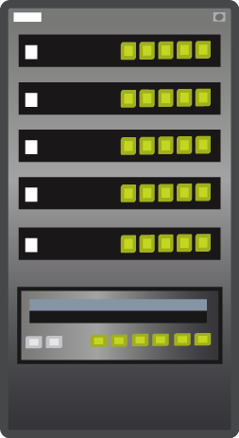
SAP Replication Server Replication and live decision support
Maintain a complete copy of the primary OLTP database
Run operational reports and queries against this copy (ODS)
Preserve transactional system processing performance
Enable more robust and responsive reporting environment
Sources can be ASE, Oracle, Microsoft, and IBM
Targets can be HANA, ASE, Oracle, Microsoft, IBM, and IQ
HA/DR warm standby can also be ODS
OLTP
DSS
DB
Rep server
Rep server
DB
* See appendix for expansion of acronyms

Slide 11



SAP Replication Server Data distribution and consolidation
New York (sales department)
San Francisco (order processing)
Microsoft
WAN
Rep option
for Microsoft
Sales support application
Order entry
application
ASE
Rep server
San Francisco (finance department)
LAN
Oracle
One example, many permutations
Continuous replication of changed data
One source to many targets
Guaranteed delivery - publish and subscribe architecture
Propagate order info to related downstream applications
Can also have bi-directional scenarios
Can also have many – one and many – many topologies
WAN
Rep option
for Oracle
Financial reporting application
Dallas (manufacturing department)
IBM
Rep option
for IBM
Manufacturing
planning application
* See appendix for expansion of acronyms

Slide 12
SAP Replication Products Product road map overview - key themes and capabilities
HADR for Suite on ASE
Zero data loss (ZDL) for Business Suite using synchronous replication
Report off-loading (reporting from standby)
Support for super-async replication mode
Virtual IP support
HANA Replication Enhancement
Database level materialization & replication
De-Pooling and BW support for HANA
Enhanced ease-of-use with RMA
Multi-site/multi-source HANA replication
Filtering and JMS support
Replication Solutions
Real-time CDC: Eliminate staging DB and PD
Data Assurance: usability enhancements
Big Data and Cloud (Phase 1)
SRS on Amazon Web Services
Hadoop as target (Phase 1)
HADR for ASE
ASE 16 SP1 support
Support for 3rd site for DR and reporting
Extend integrated HA/DR, synchronous replication feature to ASE custom apps
Advanced admin & monitoring support via RMA & SCC
HANA Replication Enhancement
HANA outbound enhancements
Replication Solutions
Data Assurance: Simplified upgrade and incremental comparisons
Big Data and Cloud (Phase 2)
Data Replication for SAP Cloud
Enhanced studio for usability
Big Data support (Phase 2: Hadoop source & MongoDB)
HANA Replication for Business Suite
ASE 16 support
HANA Replication for Business Suite on Oracle, ASE, DB2 and MSSQL with De-Clustering support
DDL replication support for HANA
HANA out-bound replication for real-time reporting (including non-BS)
Enhanced management and monitoring support with Replication Management Agent (RMA)
This is the current state of planning and may be changed by SAP at any time.

Slide 13
Product Road Map
Today
Planned
Future

Slide 14
SAP Replication Products Product road map overview - key themes and capabilities
HADR for Suite on ASE
Zero data loss (ZDL) for Business Suite using synchronous replication
Report off-loading (reporting from standby)
Support for super-async replication mode
Virtual IP support
HANA Replication Enhancement
Database level materialization & replication
De-Pooling and BW support for HANA
Enhanced ease-of-use with RMA
Multi-site/multi-source HANA replication
Filtering and JMS support
Replication Solutions
Real-time CDC: Eliminate staging DB and PD
Data Assurance: usability enhancements
Big Data and Cloud (Phase 1)
SRS on Amazon Web Services
Hadoop as target (Phase 1)
HADR for ASE
ASE 16 SP1 support
Support for 3rd site for DR and reporting
Extend integrated HA/DR, synchronous replication feature to ASE custom apps
Advanced admin & monitoring support via RMA & SCC
HANA Replication Enhancement
HANA outbound enhancements
Replication Solutions
Data Assurance: Simplified upgrade and incremental comparisons
Big Data and Cloud (Phase 2)
Data Replication for SAP Cloud
Enhanced studio for usability
Big Data support (Phase 2: Hadoop source & MongoDB)
HANA Replication for Business Suite
ASE 16 support
HANA Replication for Business Suite on Oracle, ASE, DB2 and MSSQL with De-Clustering support
DDL replication support for HANA
HANA out-bound replication for real-time reporting (including non-BS)
Enhanced management and monitoring support with Replication Management Agent (RMA)
TODAY
SRS 15.7.1 SP 200 & 202
This is the current state of planning and may be changed by SAP at any time.

Slide 15






SAP Replication Server 15.7.1 SP200 SAP HANA Replication for SAP Business Suite
SAP Replication Server (SRS) provides real time or scheduled transactional replication for SAP HANA
Source DB
ECH
WAN
ECH
Source:
SAP HANA
SAP ASE
Oracle
MS SQL
IBM DB2
SAP Replication Server for HANA
SAP Replication Server for HANA
LAN
SAP Replication Server for HANA
Real time replication solution enables both in-bound and out-bound HANA data movement
Replication Agent for Oracle, ASE, DB2 and MS SQL (RAX) provides non-intrusive, low latency change data capture for both DDL and DML
Replication Agent for HANA (RAH) enables HANA to HANA replication for both DDL and DML, optimized for real time HANA data distribution and reporting
ExpressConnect for HANA (ECH) leverages HANA native driver’s bulk capability for better performance
Support for both SAP Business Suite and non-Business Suite source applications
Heterogeneous direct load materialization (a.k.a. initial load) without downtime
Heterogeneous database level replication to HANA
Simplify installation, configuration and monitoring via RMA
Preserve Transactional Consistency between source and target databases
Flexible Deployment over LAN/WAN, with multiple sources to multiple targets topology
Data Assurance support to ensure distributed data consistency
TODAY
* See appendix for expansion of acronyms

Slide 16

SAP Replication Server 15.7.1 SP200 Heterogeneous Direct Load Materialization (DLM)
Source DB
ECH
SAP HANA
SAP ASE
Oracle
MS SQL
IBM DB2
SAP Replication Server for HANA
Direct load materialization optimized for large data volume with zero downtime
Replication to other tables not suspended during direct load materialization
Seamless integration with Replication Server
Integrated with create subscription command to table level replication definitions
Completely eliminate need for manual / bulk materialization
Multiple parallel threads can be configured to load data from one primary table to its corresponding replicate table.
Default # of thread is configured as 5.
Multiple tables can be configured for materialization in parallel
Multiple select threads per subscription can be used to improve read performance
Build-in monitoring for materialization progress for ease of management
TODAY

Slide 17
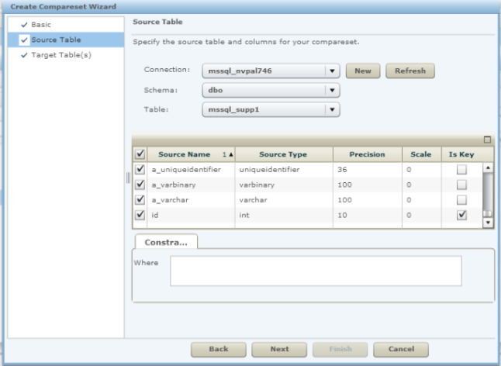

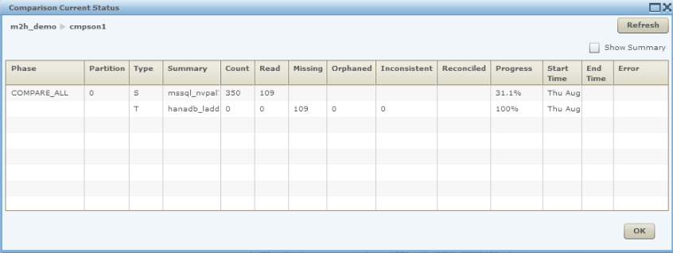





SAP Replication Server 15.7.1 SP200 Data assurance for SAP HANA
Ensures data consistency between sources and SAP HANA targets
Highly scalable and can be deployed flexibly to meet high performance and complex topology requirements
Supported database types:
HANA
IQ
ASE
Oracle
MS SQL
IBM DB2
Create CompareSet Wizard
Monitoring Comparison Job
SAP Replication Server - DA
TODAY

Slide 18
SAP Replication Server 15.7.1 SP200 Heterogeneous database level replication to HANA
Provide database level replication from ASE, UDB, Oracle and MSSQL to HANA
New syntax of “create database replication definition” command
Reduce the administration effort to manage table replication definitions, especially in large system, such as SAP Business Suite
This feature aims to enhance the usability of database replication definition and simplify the replication setup between any primary to a HANA replicate database.
Make the DDL replication more consistent without coordinating the update to the table replication definition
Alter table, create table, rename table and drop table commands are supported from heterogenous database to HANA
Enhance the database replication with additional functionality to include/exclude tables
TODAY

Slide 19
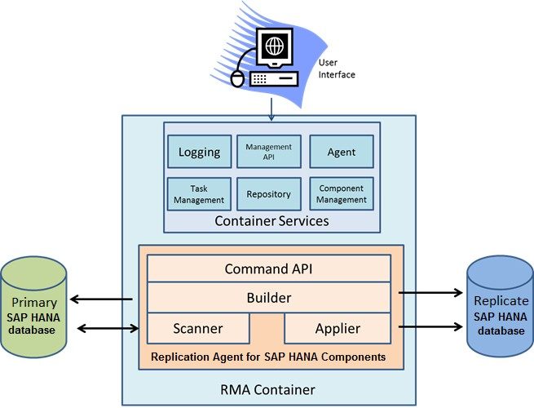
SAP Replication Server 15.7.1 SP200 Real time HANA to HANA replication
Replicates data from HANA to HANA, optimized for real time reporting and data distribution
Supports multiple replication modes
Transactional consistency
Eventual consistency
Change data capture
Transactional change data capture
Highly scalable and parallel task-based execution for both initial load and replication
Captures and replicates both DDL and DML
TODAY

Slide 20
SAP Replication Server 15.7.1 SP200 Real time HANA to HANA Replication strategies
Replication Agent for SAP HANA supports four replication strategies
Eventual consistency
Tables are scanned separately without concern for commit order.
Only primary key information and operation type is stored in the shadow tables.
Use when performance and load at the database server is more important than immediate data consistency.
Change data capture
Same as eventual consistency except it populates staging tables instead of final tables on the replicate db.
Manages the removal of data from the CDC tables.
Use when you want to stage the data before writing it to the final destination.
Transactional consistency
Updates are applied at the replicate database in the same order as they were applied at the primary database.
Txn identifiers are recorded with each database operation, and all columns are captured with every change.
Use when data consistency is more important than performance and database server load.
Transactional change data capture
Same as transactional consistency strategy except it writes to cdc tables on the replicate.
TODAY

Slide 21





SAP Replication Server 15.7.1 SP200 Replication Management Agent (RMA) support
Supported scenarios
SAP Business Suite, including cluster tables
non-Business Suite applications
Supported DBMS
HANA
Oracle
Microsoft SQL Server
IBM UDB
ASE*
Features
RMA supports following features for SRS and Replication Agents
Installation
Configuration
Monitoring
Support DBMS
Replication Agent
Replication Server
HANA Database
RMA
RMA Designer
TODAY
* Support will be provided in a later SP

Slide 22
Key benefits of SAP Replication Server for HANA
SAP Replication Server provides real-time or scheduled, low latency, transactional replication for SAP HANA
Provides real-time in-bound and out-bound HANA replication without performance impact to existing production system for both SAP Business Suite and custom applications
Preserves transactional integrity between sources and targets by capturing both Data Modification Language (DML) and Data Definition Language (DDL)
Provides ease of use with database level replication and Replication Management Agent (RMA)
Allows flexible deployment over LAN/WAN, with multiple sources to multiple targets for deployment topology
Build-in data assurance capability to ensure consistency of distributed data
TODAY

Slide 23
SAP Replication Products Product road map overview - key themes and capabilities
HADR for Suite on ASE
Zero data loss (ZDL) for Business Suite using synchronous replication
Report off-loading (reporting from standby)
Support for super-async replication mode
Virtual IP support
HANA Replication Enhancement
Database level materialization & replication
De-Pooling and BW support for HANA
Enhanced ease-of-use with RMA
Multi-site/multi-source HANA replication
Filtering and JMS support
Replication-based Solutions
Real-time CDC: Eliminate staging DB and PD
Data Assurance: usability enhancements
Big Data and Cloud (Phase 1)
SRS on Amazon Web Services
Hadoop as target (Phase 1)
HADR for ASE
ASE 16 SP1 support
Support for 3rd site for DR and reporting
Extend integrated HA/DR, synchronous replication feature to ASE custom apps
Advanced admin & monitoring support via RMA & SCC
HANA Replication Enhancement
HANA outbound enhancements
Replication-based Solutions
Data Assurance: Simplified upgrade and incremental comparisons
Big Data and Cloud (Phase 2)
Data Replication for SAP Cloud
Enhanced studio for usability
Big Data support (Phase 2: Hadoop source & MongoDB)
HANA Replication for Business Suite
ASE 16 support
HANA Replication for Business Suite on Oracle, ASE, DB2 and MSSQL with De-Clustering support
DDL replication support for HANA
HANA out-bound replication for real-time reporting (including non-BS)
Enhanced management and monitoring support with Replication Management Agent (RMA)
Planned Innovations
This is the current state of planning and may be changed by SAP at any time.

Slide 24
Planned innovations SAP Replication Server
Provide zero data loss (ZDL) replication for SAP Business Suite/ASE
HADR for SAP Business Suite on ASE
Zero data loss (ZDL) for Business Suite using synchronous replication
Report off-loading (use standby for read only reporting)
Support for super-async replication mode when network connection is down between primary and secondary
Virtual IP support
HANA Replication enhancement
De-pooling support for HANA
SAP BW support
HANA replication performance optimization
Improve ease of use via RMA
Seamless SRS and Data Services integration
Provide tighter integration between SRS and Data Services with unified management tooling and direct connectivity to improve ease of use and performance
PLANNED INNOVATIONS
* See appendix for expansion of acronyms
This is the current state of planning and may be changed by SAP at any time.

Slide 25


Planned innovations Zero data loss (ZDL) for Business Suite using synchronous replication
Replication architecture for disaster recovery setup
Business Suite
SAP Installer
DBA Cockpit
SAP Labs preview
SAP Primary System
SAP Standby (Remote) System
DR Agent
DR Agent
Sync Rep
Active ASE
Replication Server
Replication Server
Standby ASE
Replication mode can be configured as Sync, Near-Sync and Async based on SLA
Sync: ASE only commits a transaction after writing the transaction to the ASE log and after receiving ACK that RS has received and written the transactions to stable queue
Near-sync: ASE only commits a transaction after writing the transaction to ASE transaction log and after receiving ACK that SRS has received the transaction
Async: ASE doesn’t wait for ACK that SRS has received and stored the transaction before ASE commits the transaction
Admin and monitoring
Primary Replication Path
Standby Replication Path
DR Agent
PLANNED INNOVATIONS
This is the current state of planning and may be changed by SAP at any time.

Slide 26

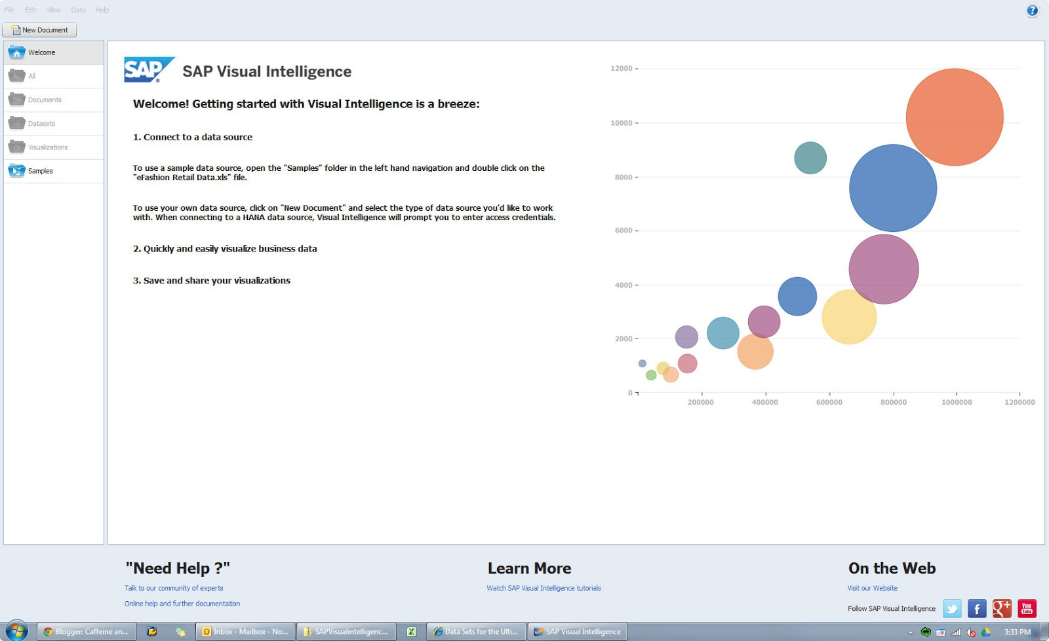
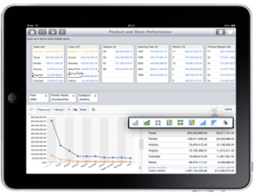
Planned innovations Report off-loading to DR site for SAP Business Suite on ASE
Replication Server provides an active standby database for ABAP reporting
Improve primary database performance by re-directing DSS workload to active standby database
Lower TCO by utilizing standby software and hardware at DR site
SAP Labs preview
SAP Business Suite ABAP reporting from standby database
SAP Business Suite
Business Suite Accelerator
Primary Server
Active Standby Server
Primary Replication Path
Standby Replication Path
PLANNED INNOVATIONS
This is the current state of planning and may be changed by SAP at any time.

Slide 27

Planned innovations Seamless SRS and Data Services integration
Provide an unified, easy to use and high performing solution for real time changed data capture (CDC), complex data transformation and data quality management
Unified admin GUI and performance monitoring
SAP Labs preview
Source DB
Sources:
SAP ASE
Oracle
MS SQL
IBM DB2/UDB
SAP Replication Server
PLANNED INNOVATIONS
This is the current state of planning and may be changed by SAP at any time.

Slide 28
SAP Replication Products Product road map overview - key themes and capabilities
HADR for Suite on ASE
Zero data loss (ZDL) for Business Suite using synchronous replication
Report off-loading (reporting from standby)
Support for super-async replication mode
Virtual IP support
HANA Replication Enhancement
Database level materialization & replication
De-Pooling and BW support for HANA
Enhanced ease-of-use with RMA
Multi-site/multi-source HANA replication
Filtering and JMS support
Replication Solutions
Real-time CDC: Eliminate staging DB and PD
Data Assurance: usability enhancements
Big Data and Cloud (Phase 1)
SRS on Amazon Web Services
Hadoop as target (Phase 1)
HADR for ASE
ASE 16 SP1 support
Support for 3rd site for DR and reporting
Extend integrated HA/DR, synchronous replication feature to ASE custom apps
Advanced admin & monitoring support via RMA & SCC
HANA Replication Enhancement
HANA outbound enhancements
Replication Solutions
Data Assurance: Simplified upgrade and incremental comparisons
Big Data and Cloud (Phase 2)
Data Replication for SAP Cloud
Enhanced studio for usability
Big Data support (Phase 2: Hadoop source & MongoDB)
HANA Replication for Business Suite
ASE 16 support
HANA Replication for Business Suite on Oracle, ASE, DB2 and MSSQL with De-Clustering support
DDL replication support for HANA
HANA out-bound replication for real-time reporting (including non-BS)
Enhanced management and monitoring support with Replication Management Agent (RMA)
Future Direction
This is the current state of planning and may be changed by SAP at any time.

Slide 29
SAP Replication Server Future direction
Provide integrated HADR for ASE custom apps & cloud data replication
Integrated HADR for ASE custom apps
SAP ASE 16 support
Extend integrated HA/DR capability to all ASE customers including ZDL with sync replication
Support for 3rd standby site for DR and HANA reporting
Advanced admin & monitoring support for replication via RMA & SCC
Data replication for Cloud & big data
Enhanced data replication for cloud ready
Transport data via web protocol (HTTP/S) natively
Provide multi-tenancy and metering support
Ease of use (self-manage)
Increase database coverage for databases don’t have logs or lack of log API
Big Data support by Hadoop integration
HDFS integration to replicate change data into Hadoop
SAP HANA
SRS compatibility with HANA Data Provisioning tools
Messaging bus support for SAP HANA database
FUTURE DIRECTION
This is the current state of planning and may be changed by SAP at any time.

Slide 30

Summary
SAP Replication Server is an industry leader, providing non-intrusive transactions capture, flexible transformations, and high performance loading in heterogeneous environments without geographical limitation while maintaining transactional integrity
Optimized and certified for SAP Business Suite on ASE to support high availability and disaster recovery
Enabling real time for HANA platform with log-based, high performance, low latency replication
Capable of powering the most demanding mission-critical systems, from Wall Street to Main Street and everywhere in between
This is the current state of planning and may be changed by SAP at any time.

Slide 31
Thank you
Road map contacts for customers and partners
Sumit Kundu | Sumit.Kundu@sap.com | Product Management

Slide 32
Key links for more information For customers and partners
Key links
Road maps on SAP Service Marketplace | http://service.sap.com/roadmap
SAP Community Network | http://www.scn.sap.com/
IT Planning Resources | https://websmp206.sap-ag.de/~sapidb/011000358700001160122012E
SAP Replication Server | http://www.sap.com/solutions/technology/database/data-replication-software/index.epx
Where to go to provide product feedback and ideas
SAP Idea Place | https://ideas.sap.com
Influence programs | http://service.sap.com/influence
SAP User Groups | http://www.sapusergroups.com/
Notes:
Do not remove the “Where to go to provide product feedback and ideas” section since this was added as per customer request/feedback
There is one page about influencing in general: http://service.sap.com/influence. It describes the Customer Engagement Initiative (CEI) and how to be informed about future registration pages (i.e. sending an email to cei@sap.com). If they’d like to hear what CEI is all about through a webcast, they can visit http://www.sap.com/demos/richmedia/media/influence-the-mid-term-product-development-of-sap-us.epx?rm_autoLaunch=true&rm_isMobile=true,width=760&height=588 link available on that page. In addition to CEI, the influence page introduces Customer Connection and Customer Advisory Councils.

Slide 33
Key links for more information For SAP internal
Key links
Road maps on SAP Service Marketplace | http://service.sap.com/roadmap
Road maps page on Corporate Portal | https://portal.wdf.sap.corp/go/roadmaps
Road map contacts
Sumit Kundu | Sumit.Kundu@sap.com | Product Management

Slide 34
Appendix

Slide 35
Acronym glossary (1 of 2)
Acronym | Full Text
ASE | Adaptive Server Enterprise
CDC | Changed Data Capture
DDL | Data Definition Language
DSI | Data Storage Interface
DSS | Decision Support System
DR | Disaster Recovery
ECDA | Enterprise Connect Data Access
ECH | Express Connect for HANA
ELT | Extract, Load, Transform
HA | High Availability
JMS | Java Message Service
LDAP | Lightweight Directory Access Protocol
MPR | Multi-Path Replication

Slide 36
Acronym glossary (2 of 2)
Acronym | Full Text
OLTP | Online Transaction Processing
ODBC | Open Database Connectivity
ODS | Operational Data Store
PDS | Primary Database Server
RAT/RAX | Replication Agent
RS | Replication Server
RSME | Replication Server Messaging Edition
SCC | SAP Control Center
SSL | Secure Socket Layer
SQL | Structured Query Language
UDB | Universal Database
ZDL | Zero Data Loss

Slide 37
Notes:
Copyright Slide – Do Not remove

